Slide 1
Telecommuting for Staff Employees Tony Yardley, SPHR, SHRM-CP December 14, 2017

Slide 2
Recent Employee Friendly Policies & Programs
Pioneer Assistance Scholarships (PAS)
Employee Emergency Assistance Fund (EEAF)
Voluntary Benefits
Pets at Work
Affinity Groups
Recognition Leave
Workplace Wellness and Exercise Program
Worksite Nursing Mothers
Flex Work
Staff Council Development Grants
Same Sex Spouses/Partner Benefits

Slide 3
Telecommuting Introduction
Pilot Program & Survey
Changing Needs
Telecommuting Benefits
Benefits Specific to TWU
Expected Increases
Quality
Quantity
Performance

Slide 4
Flex Work & Telecommuting
Expectations
Primarily Onsite
Example:
M, T, W, (7-5 onsite) Th (7-5 telecommute) F (7-11telecommute)
Primarily Telecommuting Role
Example:
M, T, (8-5 onsite) W, Th, F (8-5 telecommute)
Telecommuting Agreements Require Division VP Approval

Slide 5
Telecommuting Position Eligibility
Expectations
Limited Eligibility < 100
Limited Approval < 50
Division VP’s View of Eligibility
VP Communication & Understanding Prior to Employee Discussions

Slide 6
Telecommuting Position Eligibility
Positions Generally not Eligible
Onsite Job Duties
Front Line
Face to Face Interaction
Access to Information & Equipment
Employees in a Training Phase
Exempt & Non-Exempt

Slide 7
Telecommuting Position Eligibility
Limited Positions that may Generally be Suitable
Typically Exempt, Professional Positions
Supervision
Daily Presence not Required
Remote Work & Productivity
Limited Face to Face
Work Performed Electronically
Effective Remote Supervision

Slide 8
Characteristics of a Successful Telecommuter
Organization skills | Limited Onsite Equipment
Priorities & Time | Security
Self Motivated | Strong Performance Record
Strong Communicator | Willingness to Work Alone
Self Disciplined | Resourceful w/ Technology
Limited Supervision | Strong Job Knowledge

Slide 9
Federal and State Laws Applicable to Telecommuting
Fair Labor Standards Act (FLSA): wage and hour compliance
Workers' Compensation
Americans with Disabilities Act (ADA, ADAAA)
Family and Medical Leave (FMLA)

Slide 10
Fair Labor Standards Act (FLSA)
FLSA (Non - exempt employees)
“Hours Worked”
Supervisor Responsibility
Requires Accurate Records
Overtime Approved in Advance

Slide 11
Workers’ Compensation
Health & Safety Standards
Supervisor Notification
SORM – 30 Days
Contact Benefits Team:
Lisa Taylor, ltaylor16@twu.edu, 940-898-3542
Angela Cagle, acagle@twu.edu, 940-898-3552

Slide 12
Americans with Disabilities Act
Telecommuting Not Required by the ADA
Case by Case
Alternate Process for ADA Accommodations
Contact Tony Yardley, ayardley@twu.edu, 940-898-3563

Slide 13
Family and Medical Leave
FMLA Application to Telecommuters
Full Time Serious Health Condition
Case by Case
Process and Procedures
Contact Benefits Team:
Lisa Taylor, ltaylor16@twu.edu, 940-898-3542
Angela Cagle, acagle@twu.edu, 940-898-3552

Slide 14
Telecommuting Challenges and Solutions
Challenge: Failure to set Goals, Standards and Expectations
Possible Solution: Establish Clear Understanding:
Telecommuting Hours | Onsite Meeting Requirements | Communication Expectations
Individual and Team Goals | Cross Training & Backup Responsibilities | Technology Requirements
Performance Standards | Each Member’s Role | Success Measurements

Slide 15
Telecommuting Challenges and Solutions
Challenge: Communication and Collaboration
Possible Solutions:
Establish Regular Communication
Utilize Technology
Team Building Days
Partial Telecommuting
Onsite Celebrations of Achievements and Milestones

Slide 16
Telecommuting Challenges and Solutions
Challenge: Managing Telecommuting Problems
Possible Solutions:
One on One
Infractions
Address Issues
Adjustments

Slide 17
Telecommuting Policy Guidelines
Must Maintain Remote Worksite and Perform Work in State of Texas
Not a Substitute for Child (daycare) or Elder Care
Scheduled Remote Worksite Visits
Secure Confidential Information at Remote Site

Slide 18
Telecommuting Equipment & Supplies
Telecommuters will Provide Own Computer, Computer Peripherals, and Internet Access
Department may Choose to Purchase and Provide Some Equipment (e.g., a computer desktop or laptop)
Pre-Approval from Supervisor/Dept. Head Required for Supplies or Equipment Taken Offsite
Must use University Approved Protective Software, Like Anti-Virus Software and Malware Protection (this would come standard on TWU-owned equipment)
Employees will Provide for the Physical Labor, Transportation and Installation of TWU Owned-Equipment and Applications (although Service Desk agents are capable of walking folks through application install questions over the phone)
Employees will Bring TWU-Owned Computers Back to Campus to Office of Technology Once Each Quarter for Updates. (this can be scheduled through the Service Desk)

Slide 19
Telecommuting Agreements
Telecommuting Requests may be Considered Starting January 2, 2018
Steps:
Request from Employee (Verbal or Written)
Response by Supervisor
Requests may be Considered January 2, 2018
Division VP Approval of Positions to be Considered
Supervisor Works through the Chain of Command and Obtains Prior Approval of Positions to be Considered by Division VP

Slide 20
Telecommuting Agreements
Steps (cont.)
Division VP Communicates their View of Positions to be Considered
Following Discussion and Prior Approval, Supervisor and Employee Work Together to Complete the Telecommuting Agreement
Supervisor Submits Telecommuting Agreement through the Chain of Command for Consideration to Approve
Division VP Approval or Denial

Slide 21
Telecommuting Agreements
Telecommuting Agreements Required of all Telecommuting Arrangements of Staff Employees
Required Chain of Command Approval Including the Division VP
Must be Reviewed no later than 12 Months
Employment at Will Preserved; Not an Employment Contract
Notes:
Agreements are required of ALL STAFF EMPLOYEES
Must be approved up through Division VP
MUST BE REVIEWED ANNUALLY – NO LATER THAN 12 Months
EMPLOYMENT AT WILL IS PRESERVED
TELECOMMUTING AGREEMENTS NEVER Constitute an Employment Contract

Slide 22
Telecommuting Agreements
University may Terminate Agreement w/ Notice, Employee may Request Termination
University may Terminate w/ out Notice
Where Conflicts Arise Appeals Follow the Chain of Command with Final Appeal to Division VP
VP Decision is Final

Slide 23
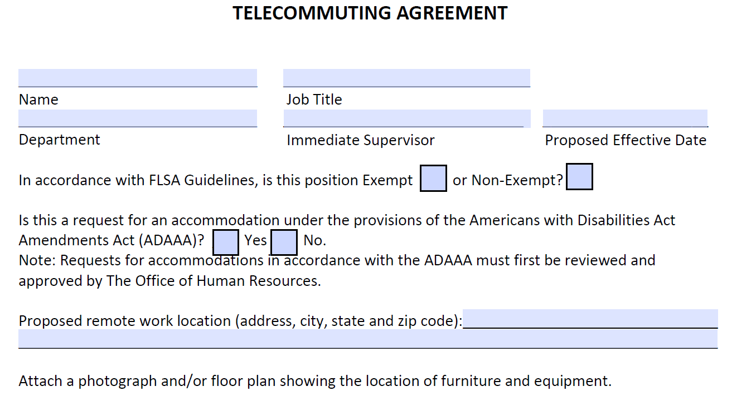
Telecommuting Agreement
PROPOSED
EFFECTIVE DATE
Exempt/Non-Exempt
ADA
PROPOSED
LOCATION
ATTACH PHOTO OR FLOOR PLAN
Notes:
Reiterate – Supervisors would want to follow the chain of command and seek approval for a position and employee to be considered
Following that Approval – Supervisors and Employees will work together to Complete the Telecommuting Agreement
Name
Title
Department
Supervisor
Proposed Effective Date
Exempt or Non Exempt
ADA
Proposed Location Address
Must attach a photograph or floorplan of the office

Slide 24
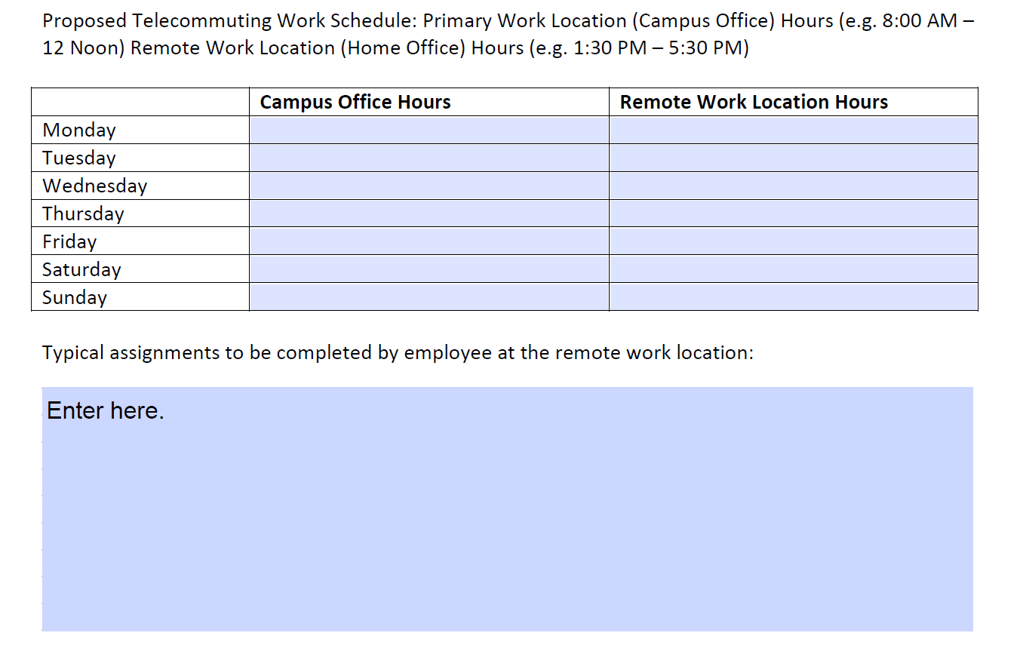
Telecommuting Agreement
PROPOSED
SCHEDULE
TYPICAL ASSIGNMENTS

Slide 25
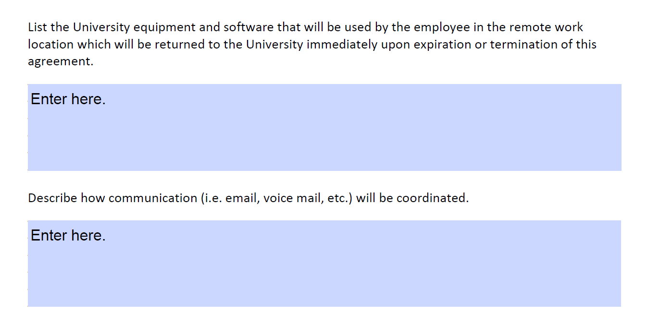
Telecommuting Agreement
UNIVERSITY EQUIPMENT & SOFTWARE
COMMUNICATION

Slide 26
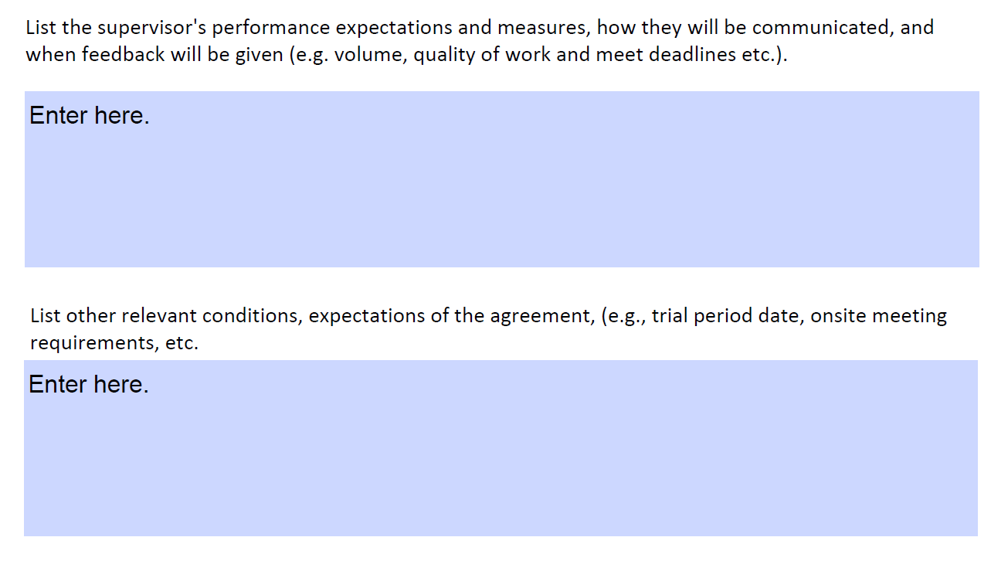
Telecommuting Agreement
PERFORMANCE EXPECTATIONS, MEASURES & FEEDBACK
OTHER
EXPECTATIONS & CONDITIONS
Notes:
Performance Expectations, Measures and How Feedback will be given
Think through your expectations
What does success look like?
How will you measure success?
How will you provide feedback to the employee?
Other Expectations & Conditions (Trial Periods, Onsite Meeting Requirements)
One of the most important concerns might be that the employee has an expectation they are not required to participate in:
1. Staff Meetings
2. Department and University Events
3. Celebrations
‘
This is the opportunity to Document

Slide 27
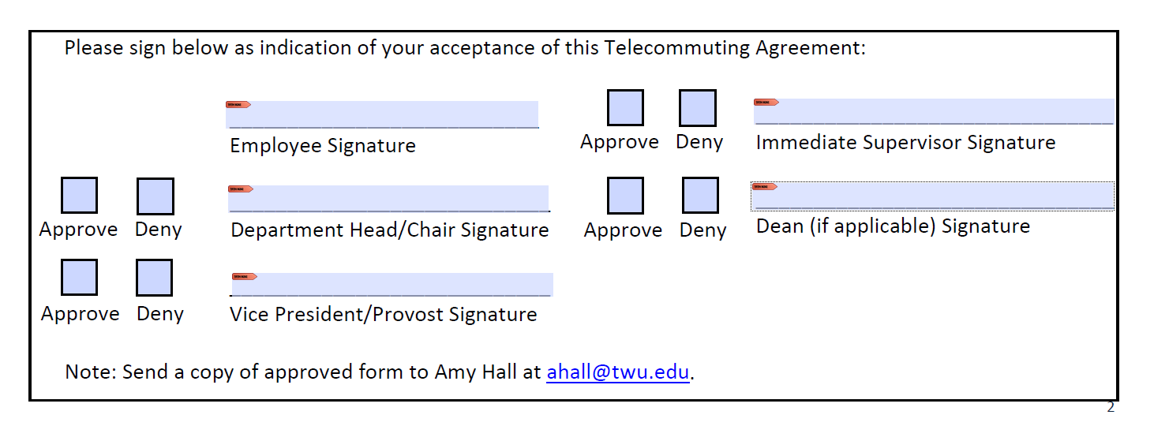
Telecommuting Agreement
Approved Agreements Forwarded to Amy Hall at ahall@twu.edu

Slide 28
FAQ available by January 2, 2018 QUESTIONS?

