Slide 1
Staff Performance Evaluation & Merit Based Compensation for Supervisors & Managers

Slide 2
Presentation Overview
Background
Goals
Self-Appraisals & Performance Evaluations
Merit Based Compensation
Questions

Slide 3
Background
July 2015: Evaluation of System
Two committees formed
Survey& town hall meeting
Recommendation of new system to be link to compensation
January 2016: Employees & Supervisor Phase 1 Training
Review of committee’s work
Introduced goals portion of the new system in SharePoint
Introduced pay for performance concept

Slide 4
Background
October 2016: Phase 2 Training
Self-Appraisals & Performance Evaluations
Merit Based Compensation Program
Nov. – Dec. 2016: Self-Appraisals/Performance Evaluations
January 2017: Merit Based Compensation
February 1, 2017: Effective date of merit increase
March 1, 2017: Merit increases reflected in paychecks

Slide 5
Background
June 2017: Next cycle expanded (January 1, 2017-May 31, 2018) to align with the academic calendar
July 31, 2017: Deadline for individual goals extended to align with division strategic goals

Slide 6
2017/2018 Goals
Goals should be completed
All regular full-time and part-time staff employees hired prior to May 1, 2018 will be evaluated and must complete goals
Scenarios:
Individual goals are aligned with division strategic goals
Individual goals are not aligned with division strategic goals
Some individual goals aligned and some not aligned with strategic goals
Some or all individual goals are not completed
Note: Performance Evaluations should be completed in a manner that ensures a fair, equitable and defendable process

Slide 7
2017/2018 Goals
Due to the Emphasis of Individual Goals tied to Division Strategic Initiatives:
Goals Question added to the
Self-Appraisal and the Performance Evaluation

Slide 8
2017/2018 Goals
Goals Scoring Weighting – Determined by Division VP’s
Student Life – 25%
Finance & Administration – 25%
Academic Affairs – 7%
Chancellor’s Office
Marketing & Communication – 50%
All other – 25%
University Advancement – 7%
Enrollment Management – 25%

Slide 9
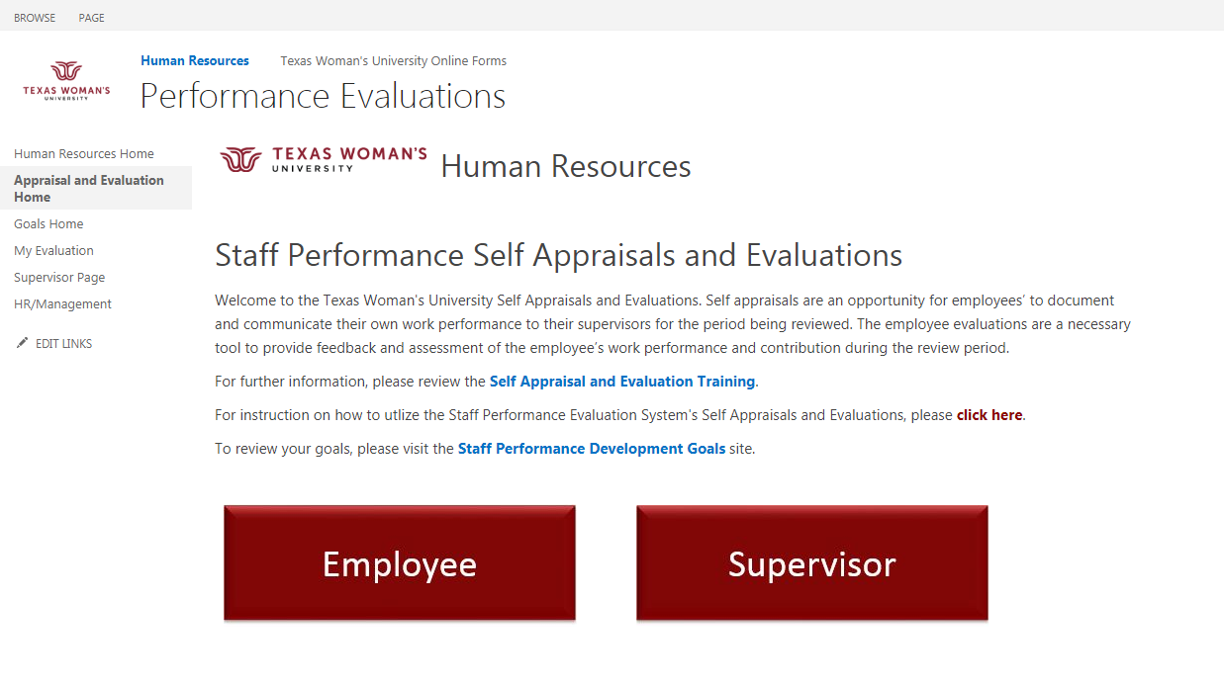
SharePoint – Self Appraisals and Evaluations
Link to Goals System
Link to Goals System

Slide 10
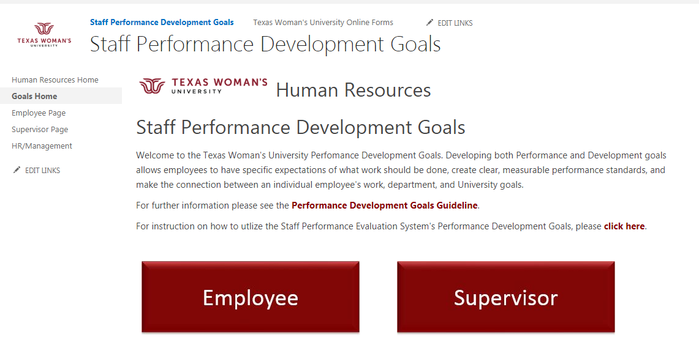
SharePoint - Goals
Review your own Goals
Review your Employee’s Goals

Slide 11
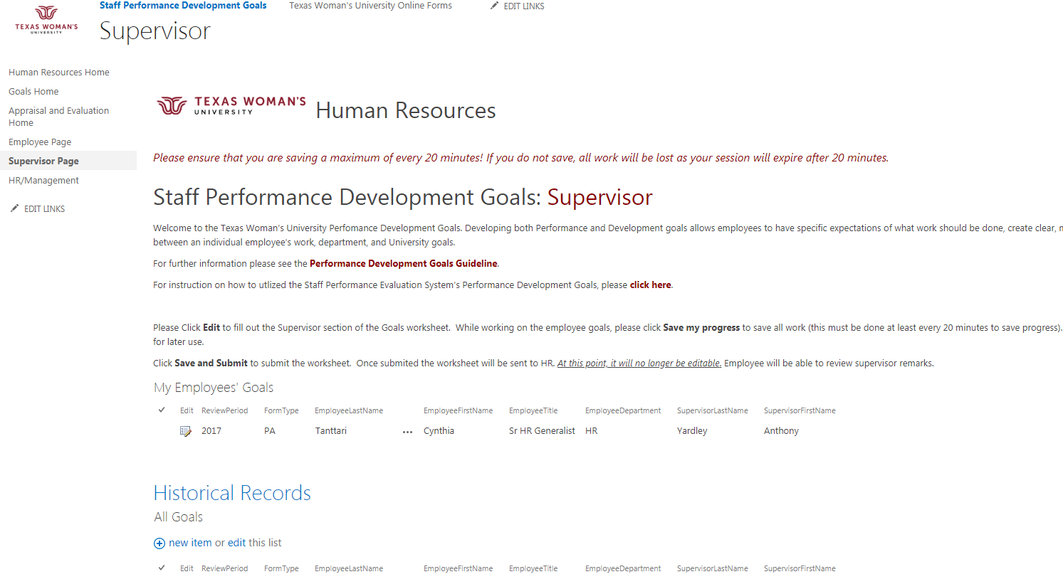
SharePoint - Goals
Link Back to Self Appraisal Performance Evaluation System
Current Employee’s Goals
Historical Record of Employee’s Goals

Slide 12
Self Appraisals
The Self Appraisals, designed by the committees to be concise and user friendly, are an opportunity for employees’ to document and communicate their own work performance to their supervisors for the period being reviewed.
Self Appraisals are initiated by the employee and are a required step in the performance evaluation process. However, they do not require supervisor approval.
Similar to the process developed in SharePoint for Goals, Self Appraisals will be entered by the employee in SharePoint. (Employees with no access to computers will be allowed to complete a paper Self-Appraisal form. Supervisors of these employees will scan and upload the paper form when completing the Performance Evaluations).
Employees will access in SharePoint by clicking on a link provided by HR

Slide 13
SharePoint – Self Appraisals and Evaluations
Complete own Self Appraisal
Review Employee’s Self Appraisals

Slide 14
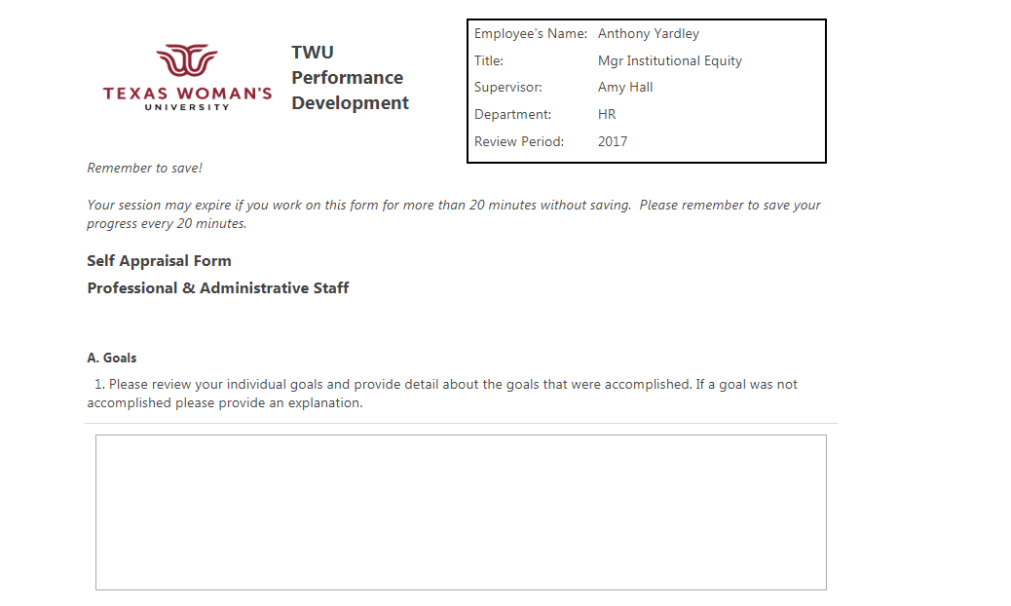
Self Appraisals
Automatically Populates
Save every
20 minutes
Goals Accomplishment

Slide 15
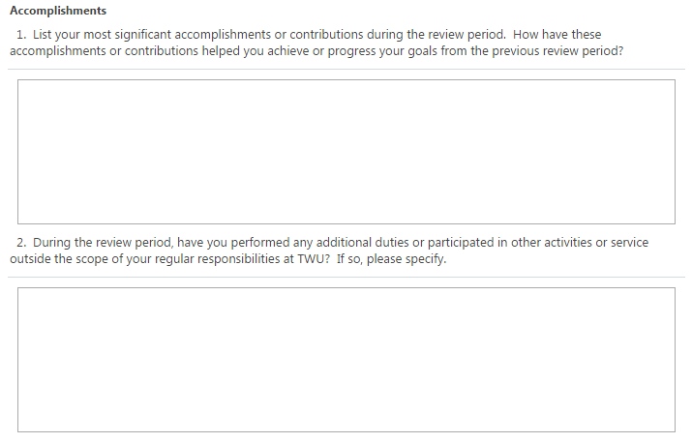
Self-Appraisals
Significant accomplishments
Additional duties & activities

Slide 16
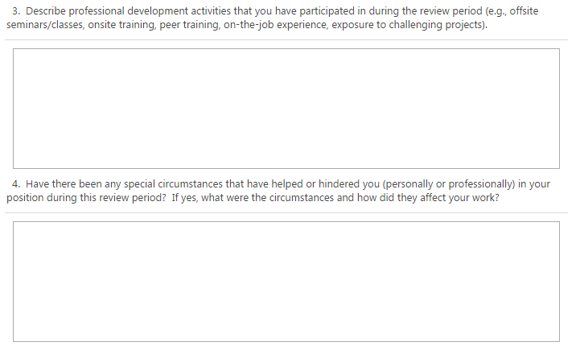
Self Appraisals
Professional development activities
Special circumstances

Slide 17
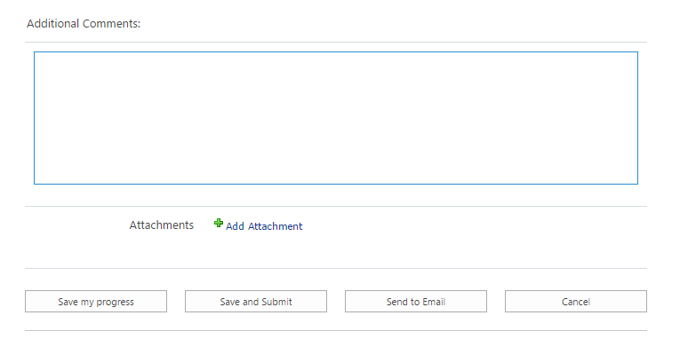
Self Appraisals
Additional comments
Add attachment
Save my progress
Save and Submit
Send to Email
Cancel

Slide 18
Performance Evaluations
Performance Evaluations, also designed to be concise and user friendly, are a necessary tool to provide feedback and assessment of the employee’s work performance and contribution during the review period.
Performance Evaluation ratings in the form of an overall score will be used to evaluate an employee’s contribution for merit based compensation.
After the Self Appraisal has been submitted by the employee, Supervisors will be notified by email when the Self-Appraisal is complete. Supervisors will review the Self-Appraisal and begin the Performance Evaluation.
Supervisors will access in SharePoint by clicking on a link provided by the workflow email or by HR

Slide 19
Performance Evaluations
Classified Staff
Goals:
1 Question
Performance Competencies:
11 Questions
3 Additional Questions for Police Officers
3 Additional Questions for Custodians, Groundskeepers and Maintenance Staff
5 Additional Questions for Supervisors

Slide 20
Performance Evaluations
Professional & Administrative Staff
Goals:
1 Question
Performance Competencies:
12 Questions
6 Additional Questions for Supervisors

Slide 21
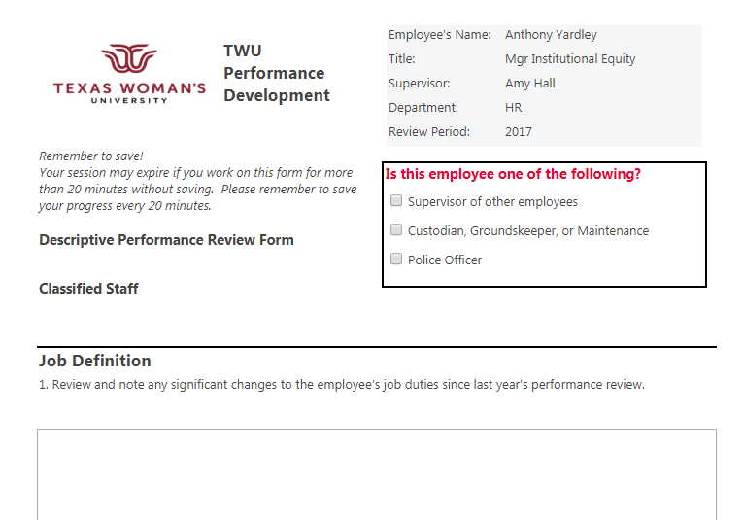
Performance Evaluations
Automatically Populates
Save every
20 minutes
Determines relevant additional questions

Slide 22
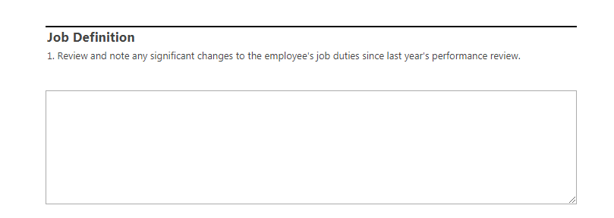
Performance Evaluations
Note significant changes to duties

Slide 23
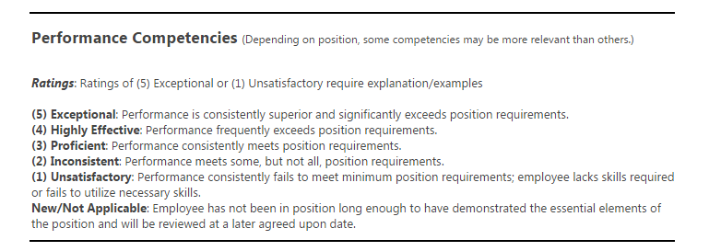
Performance Evaluations

Slide 24
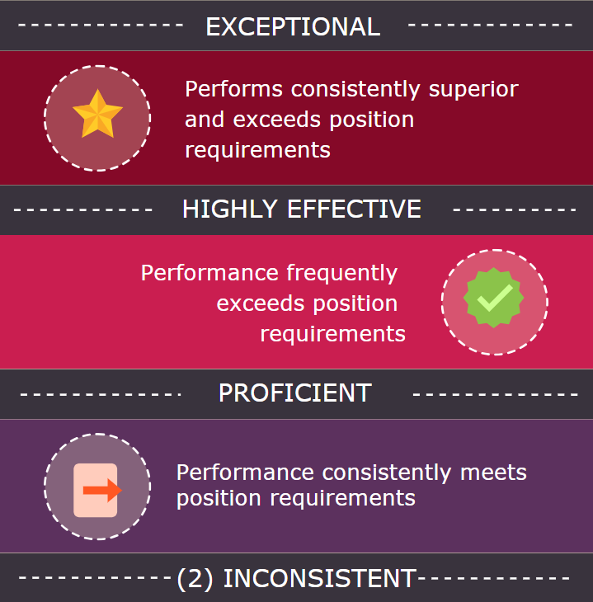

Slide 25
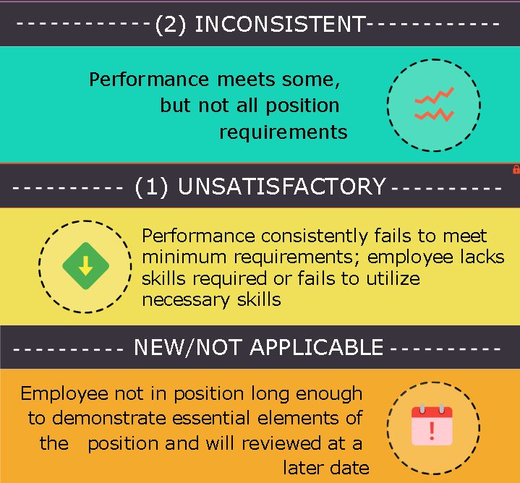

Slide 26
Performance Evaluations

Slide 27
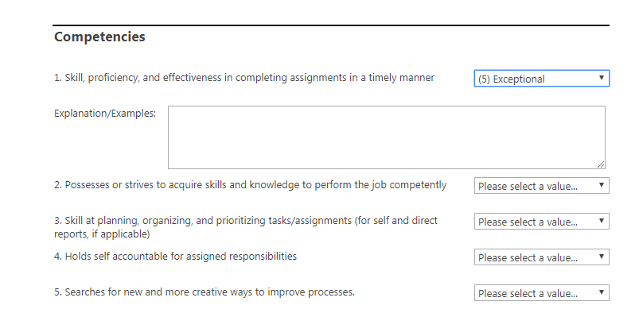
Performance Evaluations
Comments required:
5 Exceptional or 1 Unsatisfactory

Slide 28
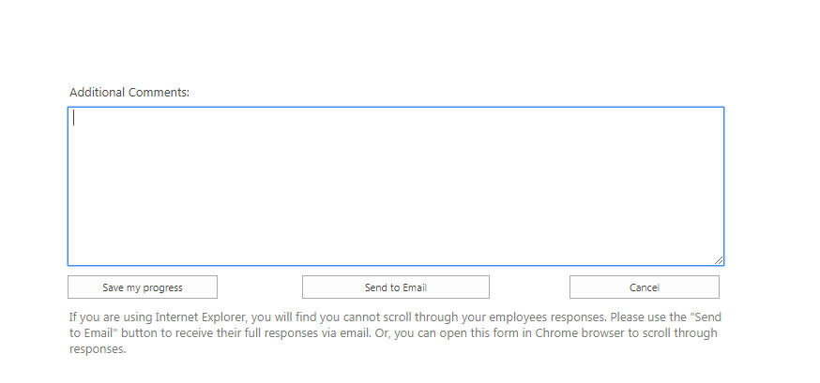
Performance Evaluations
Additional comments
Save my progress
Send to Email
Cancel

Slide 29
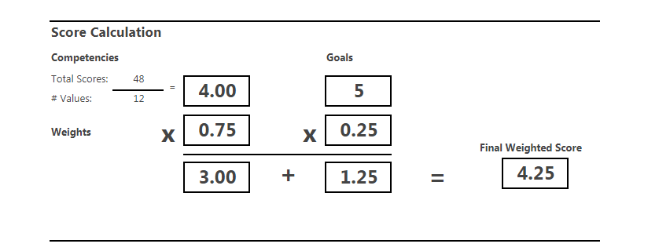
Performance Evaluations
Competencies
Weighted
Goals
Weighted
Overall Score

Slide 30
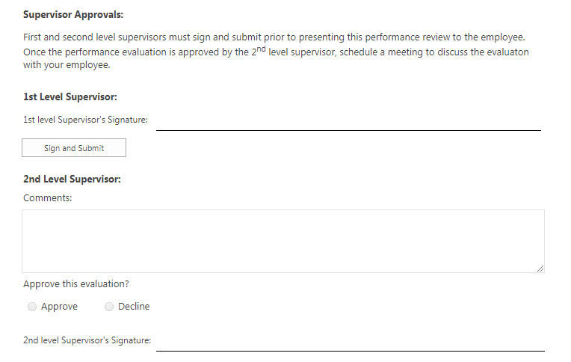
Performance Evaluations
1st Level Supervisor Sign and Submit
2nd Level Supervisor Comments
2nd Level Supervisor Approval/Reject/Signature

Slide 31
Performance Evaluations
Following Performance Evaluation,
“ I have met with my employee”
Add attachment

Slide 32
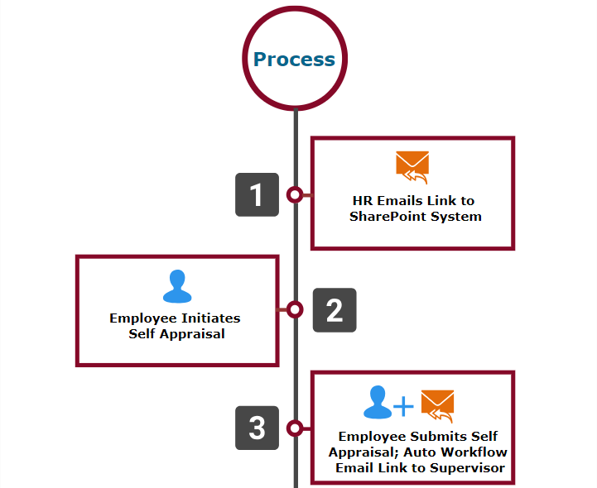
Performance Evaluations Process

Slide 33
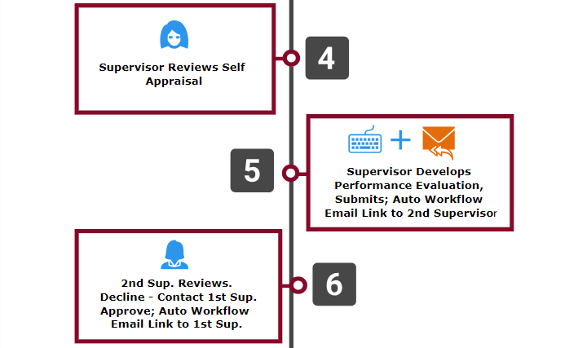

Slide 34
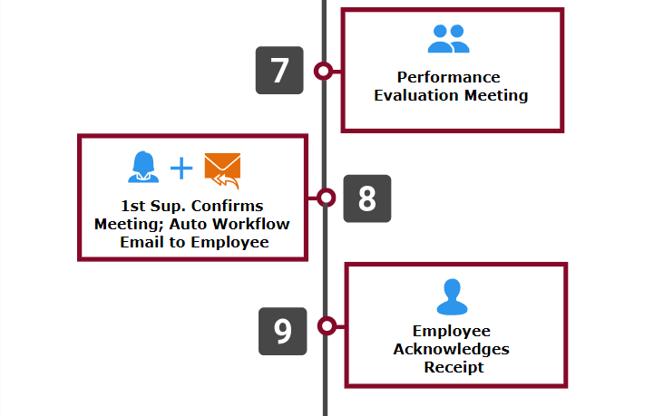

Slide 35
Performance Evaluations – Facilities Staff without Computer Access
Employee completes paper Self Appraisal
Supervisor completes Performance Evaluation in SharePoint
Supervisor emails copy of Performance Evaluation to him/herself and prints a copy
Supervisor conducts Performance Evaluation Meeting, asks employee to sign as acknowledgement
Checkbox for Supervisor, “I have met with my employee and he/she has acknowledged receipt.”
Upload scanned copies of Self Appraisal and signed Performance Evaluation

Slide 37
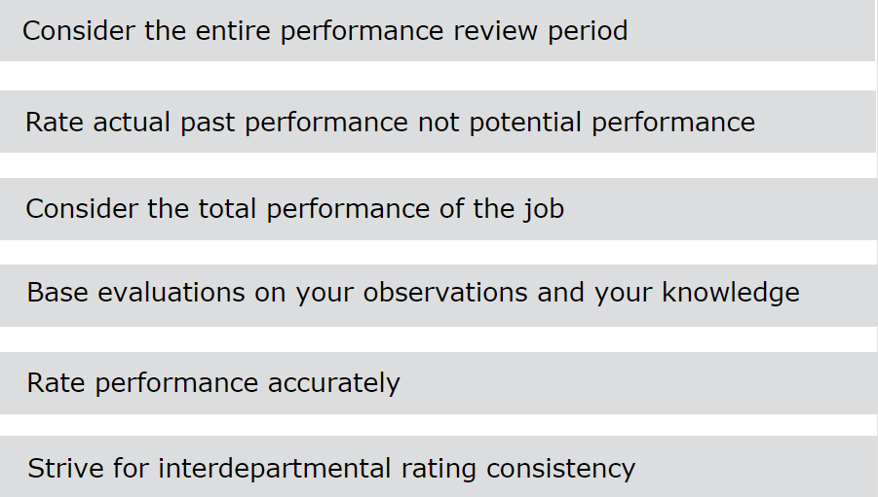

Slide 38
Performance Evaluations
OPTIONAL

Slide 39
Performance Evaluations- Common Ratings Errors
Contrast Error – tendency to compare performance to other employees
First-impression Error - tendency to initially judge “favorable” or “unfavorable,” serving as basis for evaluating performance
Recency Effect – tendency to give extra weight to recent performance and diminish performance through the review period

Slide 40
Performance Evaluations- Common Ratings Errors
Central Tendency Effect- consistently rating at or near the average or midpoint regardless of performance. Damages high performers
Negative or Positive Leniency- rating too hard or too lenient
Halo Effect– generalizing positively from one aspect of performance to all aspects of performance

Slide 41
Performance Evaluations – Common Ratings Errors
Devil Effect – generalizing from one or two negative aspects of performance and becoming blind to the positive aspects
Personal Bias– tendency to rate based on how the supervisor feels about the employee. Personal bias can stem from various sources such as colleagues, considerations of race, gender, faith, social and family background, etc.

Slide 42
Performance Evaluations – Performance Review Meeting
The Performance Evaluation Meeting is an opportunity for the supervisor and employee to review and discuss the employee’s performance over the previous review period.
The supervisor assumes a dual role. As evaluator, the supervisor will want to communicate to the employee his/her decisions concerning the ratings and the result of the performance evaluation. As coach, the supervisor will want to review accomplishments, assist the employee to solve any work related problems and suggest ideas for improvement.
The employee should feel free to point out accomplishments, identify issues and obstacles to performance as well as offer ideas and suggestions for improvement, if appropriate.
The employee should be given the opportunity ask questions and clarify expectations for the future.

Slide 43
Performance Evaluations
Meeting with the Employee
Preschedule a face to face meeting
Meet in a private place with uninterrupted time
Allow employees to read through the evaluation or
Review each question and ratings with employees
Review the overall performance
rating score

Slide 44
Performance Evaluations
Meeting with the Employee
Coach the employee on how to improve performance
Allow the employee the opportunity to ask questions
Make your expectations of future performance clear
Remind the employee about the employee acknowledgment
Be specific about the employee’s strong and weak points

Slide 45
Performance Evaluations – Timeline (Key Dates)
June 13 – June 27: Self-Appraisals entered by employees (1st level supervisors may begin evaluations as soon as Self-Appraisals are complete)
June 27-July 11: Performance Evaluations entered by 1st level supervisors (2nd level supervisors may begin approval as soon as evaluations are entered)
July 11 – July 23: Performance Evaluations reviewed and approved by 2nd level supervisors
July 23 – August 3: Performance Evaluation meetings with employees

Slide 46
Merit Based Compensation
The FY 2018 budget includes ~$2 million (2% of the total salary budget)for sustainable merit increases.
Merit is intended to reward performance and should not be allocated across the board.
A merit increase is an increase to recognize meritorious job performance but is not associated with a promotion or a change in job title resulting from a significant change in job duties.

Slide 47
Merit Based Compensation
Each department head/unit leader awarding merit should follow directions provided by their respective Vice President for the routing and approval of merit recommendations prior to submitting these recommendations to the Budget Office.
The effective date of eligible merit increases will be September 1, 2018. The monthly merit increase amount will be reflected on the October 1, 2018 paycheck.

Slide 48
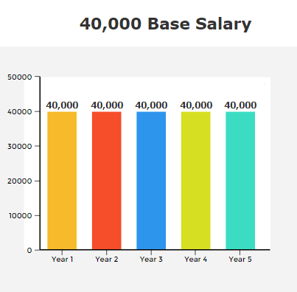
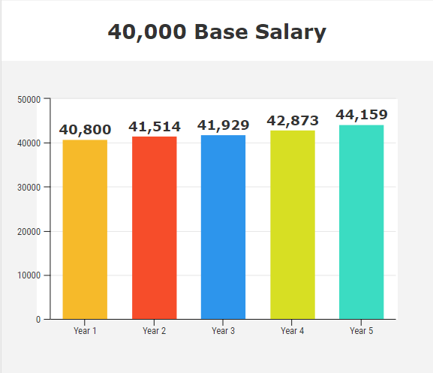
Merit Based Compensation
Example: Lump Sum Payment
Example: Increase to Base Salary
$0.00
+ $4,159

Slide 49
Merit Based Compensation
Benefits to Employees
Results in a sustainable increase that is ongoing over a long period of time
Retirement eligible(ORP and TRS)
Compounding affect of increases over multiple years
If in TRS, calculation at retirement is based on a higher annual salary resulting in a higher monthly annuity

Slide 50
Merit Based Compensation – Plan Details
Merit Increase
Exceptional – 1%
Discretionary
Merit Pay
Allocated to Departments by VP
Highly Effective – 1%
Proficient - .5%
Vary by Individual 0-7%

Slide 51
Merit Based Compensation – Plan Details
Merit Inrease(Based on Performance Evaluation):
Eligible non-exempt and exempt staff employees receiving a “Highly Effective” or “Exceptional” rating will receive a 1% merit increase
Eligible non-exempt and exempt staff employees receiving a “Proficient” rating will receive a .5% merit increase

Slide 52
Merit Based Compensation – Plan Details
Discretionary Merit Pay:
After merit increases are applied to base non-exempt and exempt staff salaries, Vice Presidents will be provided with the remaining available merit allocations (2% of the total salary budgets less the amounts awarded with the 1%, .5% merit increases and the minimum increases of $500, as described below) to be awarded to non-exempt and exempt staff employees as additional discretionary merit pay based on performance.
Discretionary merit pay amounts to vary by individual from 0-7%.
Vice Presidents will be responsible for providing allocations to their department heads/unit leaders.

Slide 53
Merit Based Compensation – Plan Details
A review of staff employees in full time positions with base salaries earning <25K (prorated for part time positions) will be conducted to ensure these employees receive a minimum of $500

Slide 54
Merit Based Compensation - Eligibility
Must have received a “Proficient” or higher on current performance evaluation
Must be employed in a regular full-time or regular part-time position
Student employees, graduate assistants and temporary employees are ineligible
Employees must have been employed in a regular full-time or part-time position prior to January 1, 2018

Slide 55
Merit Based Compensation - Eligibility
Employees in a reclassified or promoted position that resulted in a salary increase prior to January 1, 2018 are eligible
Employees in a reclassified or promoted position that resulted in a salary increase on or after January 1, 2018 are ineligible, unless the reclassified or promotion salary is less than the merit increase that would be received. Employees will receive the higher of the two, but not both.
Employees in an “interim” capacity are eligible based on their salary prior to their interim appointment.
Employees must be employed on the effective date of the merit increase, September 1, 2018, to be eligible for merit and must be employed on the date of the first paycheck, October 1, 2018, following the effective date, to receive the monthly merit increase amount.

Slide 56
Merit Based Compensation - Eligibility
Must have demonstrated meritorious performance as documented on a current year performance evaluation with a “Proficient” or higher overall rating that has been conducted in accordance with university policies. There are five levels on the staff Performance evaluation:
Rating | Scale | Eligibility
Unsatisfactory | 1 - 1.49 | Ineligible
Inconsistent | 1.5 - 2.49 | Ineligible
Proficient | 2.5 - 3.49 | Eligible
Highly Effective | 3.5 - 4.49 | Eligible
Exceptional | 4.5 - 5 | Eligible

Slide 57
Merit Eligible

Slide 58
Merit Based Compensation – Vice President Review
Merit increases awarded will be aggregated at the Vice President level and will be reviewed to ensure total merit awards are within authorized limits and that merit was not allocated across the board

Slide 59
Merit Based Compensation – Compliance Review by HR
Final merit awards will be reviewed by HR for compliance to ensure outcomes are based on non discriminatory factors

Slide 60
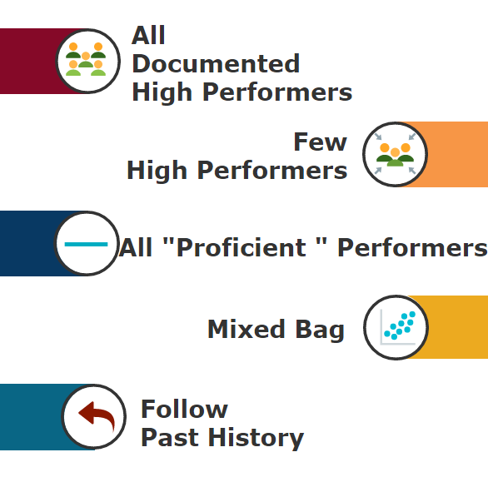
Merit
Distribution
Scenarios

Slide 61
Past History – Ratings Distribution
 | 2016 | 2015 | 2014 | 2013 | 2012
Current Rating (Prior Years Rating) | Percentage | Percentage | Percentage | Percentage | Percentage
Exceptional (Outstanding) | 10.43% | 23.78% | 28.79% | 23.49% | 24.81%
Highly Effective (Exceeds Expectations) | 59.71% | 54.97% | 50.84% | 56.51% | 53.49%
Proficient (Meets Expectations) | 29.15% | 19.56% | 19.91% | 19.45% | 20.73%
Inconsistent (Improvement Needed) | 0.71% | 1.69% | 0.46% | 0.55% | 0.97%
Unsatisfactory | 0.00% | 0.00% | 0.00% | 0.00% | 0.00%

Slide 62
REMINDER: Merit Based Compensation – Plan Details
Merit Increase
Exceptional – 1%
Discretionary
Merit Pay
Allocated to Departments by VP
Highly Effective – 1%
Proficient - .5%
Vary by Individual 0-7%

Slide 63
Merit Distribution – Discretionary Merit Pay
After you have objectively completed each employee evaluation and scores have been calculated, begin your proposed merit distribution for discretionary merit pay considering the following suggested factors:
Suggested Factors
Student/customer service
Knowledge of the requirements of the position
Quality of work
Ability to handle responsibility
Work productivity

Slide 64
Merit Distribution – Discretionary Merit Pay
Suggested Factors
Demonstrated initiative
Attendance record
Mentor and leadership qualities
Job related education and certifications
Competencies and skills
Teamwork, collaboration and cooperation
TWU community involvement
Driving the strategic initiatives of the dept./university

Slide 65
Merit Based Compensation – Timeline (Key Dates)
August 6: Merit spreadsheets provided to VP’s
August 20: VP’s submit final merit awards based on known salaries
September 1: Effective date of eligible merit increases
September 14 – September 21: Merit notification letters
October 1: Eligible monthly merit increase amount reflected in paychecks

Slide 66
QUESTIONS?

Slide 67
Contact information
Tony Yardley
Director of Employee Relations, HR Compliance & Equity
940-898-3563, ayardley@twu.edu
Cyndee Tanttari
Sr. HR Generalist – Employee Relations, HR Compliance & Equity
940-898-3553, ctanttari@twu.edu

